Slide 1
Spring Microservices
By Ahmed Hisham

Slide 2
Agenda
Evolution of Microservices.
01
Definition of Microservices.
02
Concepts and Characteristics.
03
Typical Use cases of microservice architecture.
04
Microservice / SOA / Twelve-Factor Apps.
05

Slide 3
Microservice Definition!
The following section gives different “arbitrary” definitions for Microservices, as there is no single, concrete, and universally accepted definition for microservices.
However, all successful microservices implementations exhibit a number of common characteristics
It is important to understand these characteristics rather than sticking to theoretical definitions

Slide 4
Evolution of Microservices.
Microservices are an architecture style and an approach for software development to satisfy modern business demands.
Microservices are not invented; they are more of an evolution from the previous architecture styles
Microservices are one of the increasingly popular architecture patterns next to SOA, complemented by DevOps and cloud
Microservices provide an approach for developing quick and agile applications, resulting in less overall cost.
Microservices are an architectural style or an approach to building IT systems as a set of business capabilities that are autonomous, self-contained, and loosely coupled

Slide 5
Enterprises are no longer interested in developing consolidated applications to manage their end-to-end business functions as they did a few years ago.
As microservices are more aligned to business capabilities and have independently manageable life cycles, they are the ideal choice for enterprises embarking on DevOps and cloud. DevOps and cloud are two facets of microservices.
DevOps is an IT realignment to narrow the gap between traditional IT development and operations for better efficiency.

Slide 6
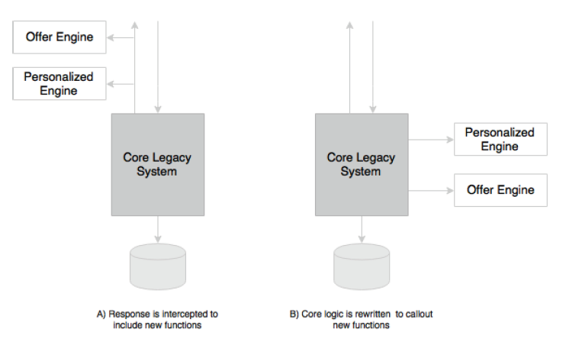
Notes:
A) Pass the response through new functions.
B) Modify core legacy system to call out these functions as part of the processing.
These functions are typically written as microservices.

Slide 7
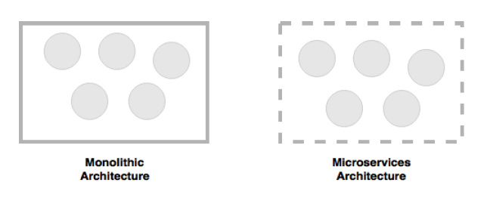
Microservices help us break the boundaries of monolithic applications and build a logically independent smaller system of systems.
If we consider monolithic applications as a set of logical subsystems encompassed with a physical boundary, microservices are a set of independent subsystems with no enclosing physical boundary.

Slide 8
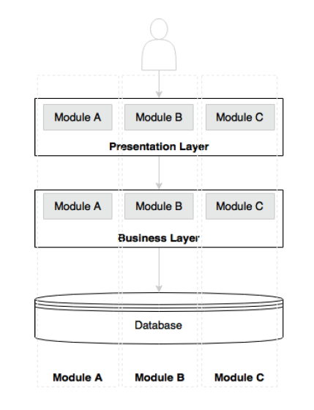
Typical N-tier architecture

Slide 9
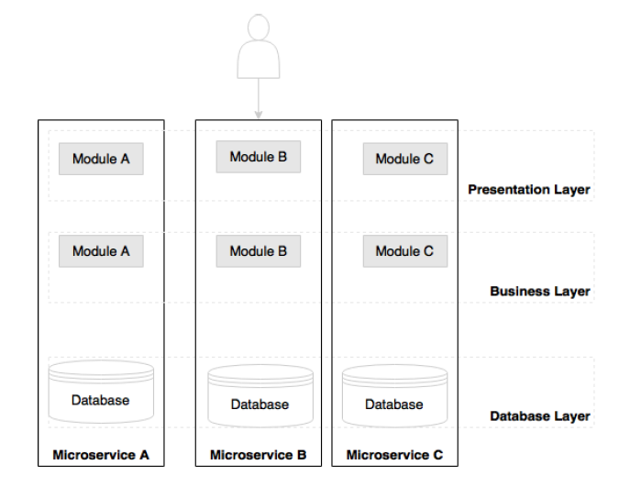
Microservice-Based Architecture

Slide 10
Principles of Microservices
Single Responsibility per Service
Microservices are autonomous

Slide 11
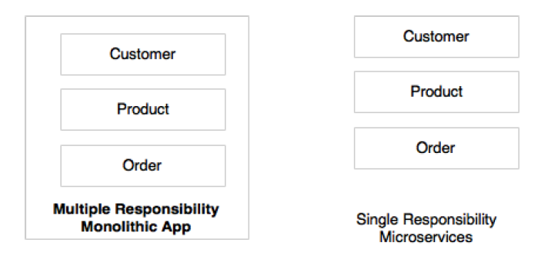
Microservices Have Single Responsibility

Slide 12
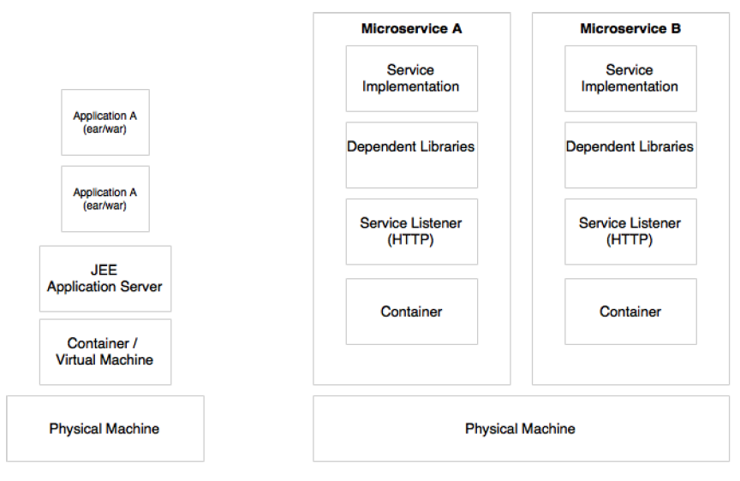
Microservices are Autonomous

Slide 13
Microservices are Autonomous (Cont.)
Microservices are self-contained, independently deployable, and autonomous services that take full responsibility of a business capability and its execution
Microservices bundle all dependencies, including library dependencies, and execution environments such as web servers and containers or virtual machines that abstract physical resources.

Slide 14
Microservices VS SOA
One of the major differences between microservices and SOA is in their level of autonomy. While most SOA implementations provide service-level abstraction, microservices go further and abstract the realization and execution environment.
Notes:
In traditional application developments, we build a WAR or an EAR, then deploy it into a JEE application server, such as with JBoss, WebLogic, WebSphere, and so on. We may deploy multiple applications into the same JEE container. In the microservices approach, each microservice will be built as a fat Jar, embedding all dependencies and run as a standalone Java process.
Microservices may also get their own containers for execution. Containers are portable, independently manageable, lightweight runtime environments. Container technologies, such as Docker, are an ideal choice for microservices deployment.

Slide 15
Microservices, First-Class Citizens
Microservices expose service endpoints as APIs and abstract all their realization details.
The internal implementation logic, architecture, and technologies (including programming language, database, quality of services mechanisms, and so on) are completely hidden behind the service API.
Notes:
Moreover, in the microservices architecture, there is no more application development; instead, organizations focus on service development. In most enterprises, this requires a major cultural shift in the way that applications are built.
In a Customer Profile microservice, internals such as the data structure, technologies, business logic, and so on are hidden. They aren't exposed or visible to any external
entities. Access is restricted through the service endpoints or APIs. For instance, Customer Profile microservices may expose Register Customer and Get Customer
as two APIs for others to interact with.

Slide 16
Characteristics of Microservices
This is much like SOA’s characteristics:
Service-contract.
Loose coupling.
Service abstraction.
Service reuse.
Statelessness
Services are discoverable
Service Interoperability
Service Composability
Notes:
Service contract: Similar to SOA, microservices are described through well-defined service contracts. In the microservices world, JSON and REST are universally accepted for service communication. In the case of JSON/REST, there are many techniques used to define service contracts. JSON Schema, WADL, Swagger, and RAML are a few examples.
Loose coupling: Microservices are independent and loosely coupled. In most cases, microservices accept an event as input and respond with another event. Messaging, HTTP, and REST are commonly used for interaction between microservices. Message-based endpoints provide higher levels of decoupling.
Service abstraction: In microservices, service abstraction is not just an abstraction of service realization, but it also provides a complete abstraction of all libraries and environment details.
Service reuse: Microservices are course-grained reusable business services. These are accessed by mobile devices and desktop channels, other microservices, or even other systems.
Statelessness: Well-designed microservices are stateless and share nothing with no shared state or conversational state maintained by the services. In case there is a requirement to maintain state, they are maintained in a database, perhaps in memory.
Services are discoverable: Microservices are discoverable. In a typical microservices environment, microservices self-advertise their existence and make themselves available for discovery. When services die, they automatically take themselves out from the microservices ecosystem.
Service interoperability: Services are interoperable as they use standard protocols and message exchange standards. Messaging, HTTP, and so on are used as transport mechanisms. REST/JSON is the most popular method for developing interoperable services in the microservices world. In cases where further optimization is required on communications, other protocols such as Protocol Buffers, Thrift, Avro, or Zero MQ could be used. However, the use of these protocols may limit the overall interoperability of the services
Service composability: Microservices are composable. Service composability is achieved either through service orchestration or service choreography.

Slide 17
Microservices are lightweight
Microservices perform only one function.
As a result, microservices with small footprints.
Choose lightweight web containers to ensure that overall footprint remains manageable*.
Notes:
For example, Jetty or Tomcat are better choices as application containers for microservices compared to more complex traditional application servers such as WebLogic or WebSphere.
Container technologies such as Docker also help us keep the infrastructure footprint as minimal as possible compared to hypervisors such as VMWare or Hyper-V.

Slide 18
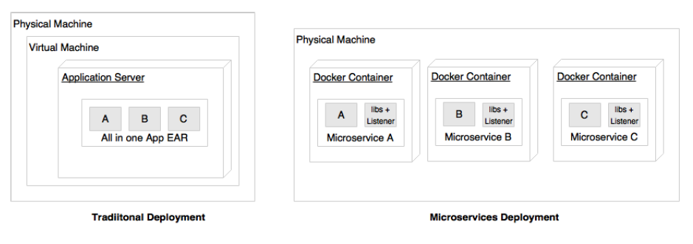
Traditional VS Microservices Deployment
Notes:
Microservices are deployed in Docker containers, which encapsulate the business logic and needed libraries.
This help us quickly replicate the entire setup on a new machine or on a completely different hosting environment or even to move across different cloud providers.
As there is no physical infrastructure dependency, containerized microservices are easily portable.

Slide 19
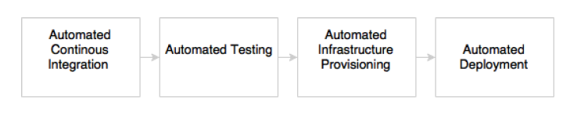
Automation in microservice environment
Notes:
Most of the microservices implementations are automated to a maximum from development to production.
A large number of microservices is hard to manage until and unless automation is in place. The smaller footprint of microservices also helps us automate the microservices development to the deployment life cycle.
Microservices are automated end to end—for example, automated builds, automated testing, automated deployment, and elastic scaling.
As indicated in the preceding diagram, automations are typically applied during the development, test, release, and deployment phases

Slide 20
Automation in Microservice Environment
Most of the microservices implementations are automated to a maximum from development to production.
A large number of microservices is hard to manage until and unless automation is in place. The smaller footprint of microservices also helps us automate the microservices development to the deployment life cycle.
Microservices are automated end to end—for example, automated builds, automated testing, automated deployment, and elastic scaling.

Slide 21
Development Automation Phase
The development phase is automated using version control tools such as Git together with Continuous Integration (CI) tools such as Jenkins, Travis CI, and so on. This may also include code quality checks and automation of unit testing. Automation of a full build on every code check-in is also achievable with microservices.

Slide 22
Testing Automation Phase
The testing phase will be automated using testing tools such as Selenium, Cucumber, and other AB testing strategies. As microservices are aligned to business capabilities, the number of test cases to automate is fewer compared to monolithic applications, hence regression testing on every build also becomes possible.

Slide 23
Infrastructure provisioning Automation Phase
Infrastructure provisioning is done through container technologies such as Docker, together with release management tools such as Chef or Puppet, and configuration management tools such as Ansible.
Automated deployments are handled using tools such as Spring Cloud, Kubernetes, Mesos, and Marathon.

Slide 24
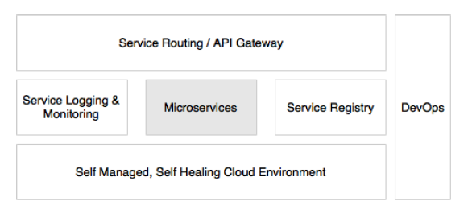
Microservices with a supporting ecosystem
Notes:
Most of the large-scale microservices implementations have a supporting ecosystem in place. The ecosystem capabilities include DevOps processes, centralized log management, service registry, API gateways, extensive monitoring, service routing, and flow control mechanisms

Slide 25
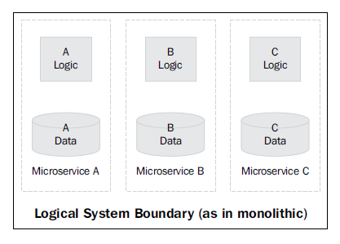
Microservices are distributed and dynamic
Notes:
The dotted line in the preceding diagram implies the logical monolithic application boundary. When we migrate this to microservices, each microservice A, B, and C creates its own physical boundaries.

Slide 26
Microservices are distributed and dynamic (Cont.)
Successful microservices implementations encapsulate logic and data within the service. This results in two unconventional situations: distributed data and logic and decentralized governance.
Compared to traditional applications, which consolidate all logic and data into one application boundary, microservices decentralize data and logic. Each service, aligned to a specific business capability, owns its data and logic.

Slide 27
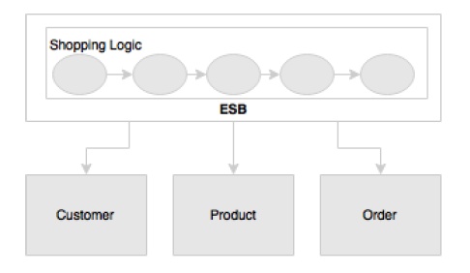
SOA Implementation Using ESB
Notes:
A typical SOA implementation.
Shopping logic is fully implemented in ESB by orchestrating different services exposed by Customer, Order, and Product
SOA implementations heavily relay on static registry and repository configurations to manage services and other artifacts
In the microservices approach, on the other hand, Shopping itself will run as a separate microservice, which interacts with Customer, Product, and Order in a fairly decoupled way.
Microservices bring a more dynamic nature into this. Hence, a static governance approach is seen as an overhead in maintaining up-to-date information. This is why most of the microservices implementations use automated mechanisms to build registry information dynamically from the runtime topologies.

Slide 28
Antifragility, Fail Safe, Self Healing (Antifragility)
Antifragility is a technique successfully experimented at Netflix. It is one of the most powerful approaches to building fail-safe systems in modern software development.
In the antifragility practice, software systems are consistently challenged
Notes:
The antifragility concept is introduced by Nassim Nicholas Taleb in his book Antifragile: Things That Gain from Disorder

Slide 29
Antifragility, Fail Safe, Self Healing (Fail Safe)
Fail safe is another concept used to build fault-tolerant, resilient systems.
This philosophy advocates systems that expect failures versus building systems that never fail.
Importance should be given to how quickly the system can fail and if it fails, how quickly it can recover from this failure
With this approach, the focus is shifted from Mean Time Between Failures (MTBF) to Mean Time To Recover (MTTR).
A key advantage of this approach is that if something goes wrong, it kills itself, and downstream functions aren't stressed.
Notes:
The antifragility concept is introduced by Nassim Nicholas Taleb in his book Antifragile: Things That Gain from Disorder

Slide 30
Antifragility, Fail Safe, Self Healing (Self Healing)
Self-healing is commonly used in microservices deployments, where the system automatically learns from failures and adjusts itself. These systems also prevent future failures.
Notes:
The antifragility concept is introduced by Nassim Nicholas Taleb in his book Antifragile: Things That Gain from Disorder

Slide 31
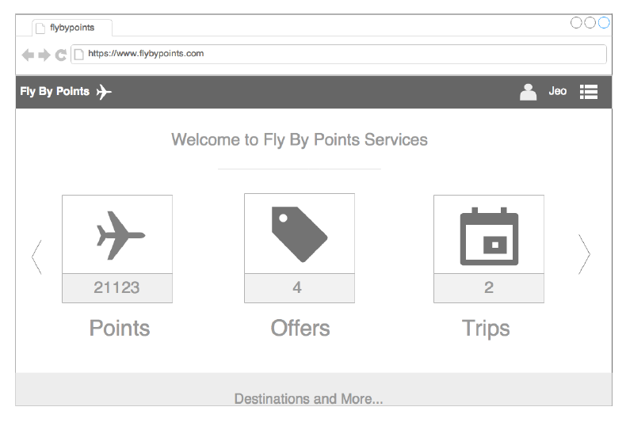
Microservice Examples: Fly By Points
Notes:
Fly By Points collects points that are accumulated when a customer books a hotel, flight, or car through the online website.
When the customer logs in to the Fly By Points website, he/she is able to see the points accumulated, personalized offers that can be availed of by redeeming the points, and upcoming trips if any.

Slide 32
Fly By Points: Desc.
Fly By Points collects points that are accumulated when a customer books a hotel, flight, or car through the online website. When the customer logs in to the Fly By Points website, he/she is able to see the points accumulated, personalized offers that can be availed of by redeeming the points, and upcoming trips if any.

Slide 33
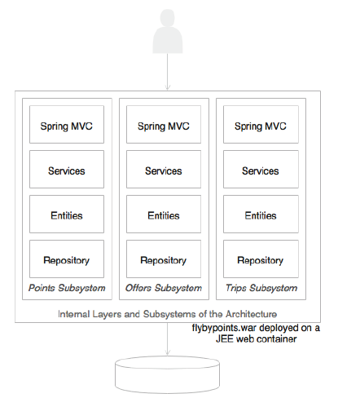
Monolithic Approach (Traditional Way)
Notes:
The holiday portal's architecture is web-based and modular, with a clear separation between layers
The holiday portal is also deployed as a single WAR file on a web server such as Tomcat
Data is stored on an all-encompassing backing relational database.

Slide 34
Pros.
This is a good fit for the purpose architecture when the complexities are few

Slide 35
Cons.
As the business grows, the user base expands, and the complexity also increases
This results in a proportional increase in transaction volumes

Slide 36
What to do ?
enterprises should look to rearchitecting the monolithic application to microservices for better speed of delivery, agility, and manageability

Slide 37
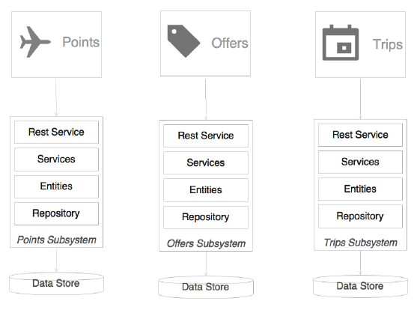
Microservice Approach
Notes:
Notice:
Each subsystem has now become an independent system by itself, a microservice
There are three microservices representing three business functions: Trips, Offers, and Points. Each one has its internal data store and middle layer. The internal structure of each service remains the same.
Each service encapsulates its own database as well as its own HTTP listener.
As opposed to the previous model, there is no web server or WAR. Instead, each service has its own embedded HTTP listener, such as Jetty, Tomcat, and so on.
Each microservice exposes a REST service to manipulate the resources/entity that belong to this service.

Slide 38
Microservice Approach (Cont.)
It is assumed that the presentation layer is developed using a client-side JavaScript MVC framework such as Angular JS. These client-side frameworks are capable of invoking REST calls directly
When the web page is loaded, all the three boxes, Trips, Offers, and Points will be displayed with details such as points, the number of offers, and the number of trips.
This will be done by each box independently making asynchronous calls to the respective backend microservices using REST.

Slide 39
Microservice Approach (Cont.)
There is no dependency between the services at the service layer.
When the user clicks on any of the boxes, the screen will be transitioned and will load the details of the item clicked on. This will be done by making another call to the respective microservice

Slide 40
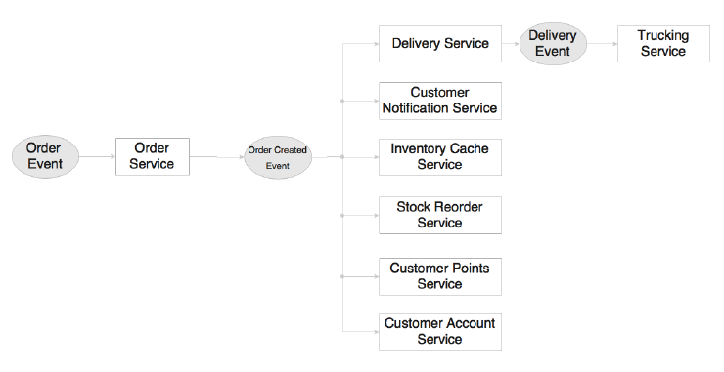
Microservices Example: Order Management System
Notes:
Here, Order Service processes the Order Event generated when a customer places an order through the website.
This is based on reactive programming practices.
In the preceding diagram, there are eight microservices shown. The following activities take place upon the arrival of Order Event:
1. Order Service kicks off when Order Event is received. Order Service creates an order and saves the details to its own database.
2. If the order is successfully saved, Order Successful Event is created by Order Service and published.
3. A series of actions take place when Order Successful Event arrives.
4. Delivery Service accepts the event and places Delivery Record to deliver the order to the customer. This, in turn, generates Delivery Event and publishes the event.
5. Trucking Service picks up Delivery Event and processes it. For instance, Trucking Service creates a trucking plan.
6. Customer Notification Service sends a notification to the customer informing the customer that an order is placed.
7. Inventory Cache Service updates the inventory cache with the available product count.
8. Stock Reorder Service checks whether the stock limits are adequate and generates Replenish Event if required.
9. Customer Points Service recalculates the customer's loyalty points based on this purchase.
10. Customer Account Service updates the order history in the customer’s account.

Slide 41
Order Management System (Cont.)
When an event is published, a number of microservices are ready to kick-start upon receiving the event. Each one of them is independent and does not rely on other microservices.
The advantage of this model is that we can keep adding or replacing microservices to achieve specific needs.

Slide 42
Order Management System (Cont.)
In this approach, each service is responsible for only one function.
Services accept and generate events.
Each service is independent and is not aware of its neighborhood.
New services can be added as and when necessary.
Adding a new service does not impact any of the existing services.

Slide 43
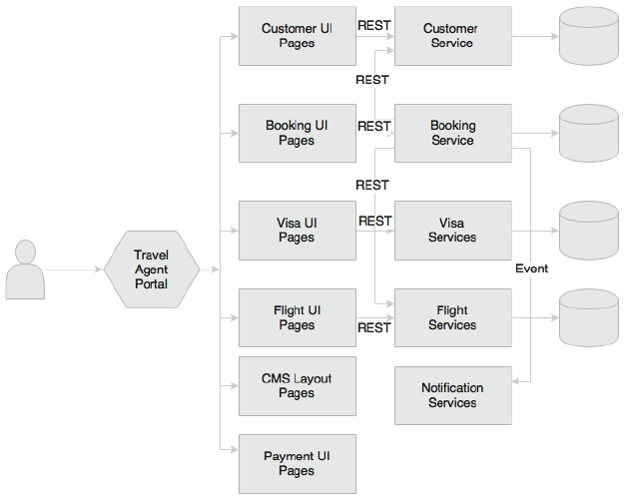
Microservices Example: Travel Agent Portal
Notes:
In this example, we will see both synchronous REST calls as well as asynchronous events.
Here, The portal is just a container application with multiple menu items or links in the portal.
When specific pages are requested—for example, when the menu or a link is clicked on—they will be loaded from the specific microservices
When a customer requests a booking, the following events take place internally:
1. The travel agent opens the flight UI, searches for a flight, and identifies the right flight for the customer. Behind the scenes, the flight UI is loaded from the Flight microservice. The flight UI only interacts with its own backend APIs within the Flight microservice. In this case, it makes a REST call to the Flight microservice to load the flights to be displayed.
2. The travel agent then queries the customer details by accessing the customer UI. Similar to the flight UI, the customer UI is loaded from the Customer microservice. Actions in the customer UI will invoke REST calls on the Customer microservice. In this case, customer details are loaded by invoking appropriate APIs on the Customer microservice.
3. Then, the travel agent checks the visa details for the customer's eligibility to travel to the selected country. This also follows the same pattern as mentioned in the previous two points.
4. Next, the travel agent makes a booking using the booking UI from the Booking microservice, which again follows the same pattern.
5. The payment pages are loaded from the Payment microservice. In general, the payment service has additional constraints such as PCIDSS compliance (protecting and encrypting data in motion and data at rest).
The advantage of the microservices approach is that none of the other microservices need to be considered under the purview of PCIDSS as opposed to the monolithic application, where the complete application comes under the governing rules of PCIDSS. Payment also follows the same pattern as described earlier.
6. Once the booking is submitted, the Booking microservice calls the flight service to validate and update the flight booking. This orchestration is defined as part of the Booking microservice. Intelligence to make a booking is also held within the Booking microservice. As part of the booking process, it also validates, retrieves, and updates the Customer microservice.
7. Finally, the Booking microservice sends the Booking Event, which the notification service picks up and sends a notification of to the customer.

Slide 44
What to notice …
we can change the user interface, logic, and data of a microservice without impacting any other microservices
This is a clean and neat approach. A number of portal applications can be built by composing different screens from different microservices, especially for different user communities. The overall behavior and navigation will be controlled by the portal application.

Slide 45
What to notice …
The approach has a number of challenges unless the pages are designed with this approach in mind.
Note that the site layouts and static content will be loaded by the Content Management System (CMS) as layout templates. Alternately, this could be stored in a web server.
The site layout may have fragments of UIs that will be loaded from the microservices at runtime

Slide 46
Microservices benefits
Supports polyglot architecture
Enabling experimentation and innovation
Elastically and selectively scalable
Allowing substitution
Enabling to build organic systems
Helping reducing technology debt
Allowing the coexistence of different versions
Supporting the building of self-organizing Systems
Supporting event-driven architecture
Enabling DevOps

Slide 47
1. Supports Polyglot Architecture
Architects and developers can now choose “fit-for-purpose” architecture and technologies for each microservice.
This gives the flexibility to design better-fit solutions in a more cost-effective way.
As microservices are autonomous and independent, each service can run with its own architecture or technology or different versions of technologies

Slide 48
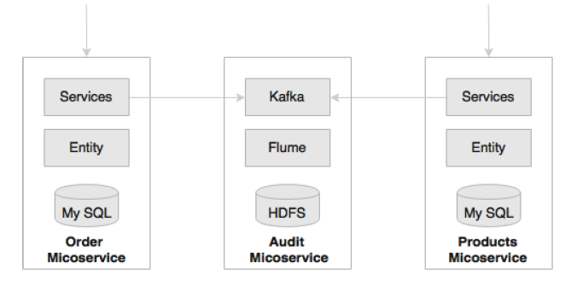
Example
Notes:
There is a requirement to audit all system transactions and record transaction details such as request and response data, the user who initiated the transaction, the service invoked, and so on.
As shown in the preceding diagram, while core services such as the Order and Products microservices use a relational data store, the Audit microservice persists data in Hadoop File System (HDFS).
A relational data store is neither ideal nor cost effective in storing large data volumes such as in the case of audit data. In the monolithic approach, the application generally uses a shared, single database that stores Order, Products, and Audit data.
In this example, the audit service is a technical microservice using a different architecture. Similarly, different functional services could also use different architectures.
In another example, there could be a Reservation microservice running on Java 7, while a Search microservice could be running on Java 8. Similarly, an Order microservice could be written on Erlang, whereas a Delivery microservice could be on the Go language. None of these are possible with a monolithic architecture.

Slide 49
2. Enabling experimentation and innovation
Modern enterprises are thriving towards quick wins.
Microservices are one of the key enablers for enterprises to do disruptive innovation by offering the ability to experiment and fail fast.
With large monolithic applications, experimentation was not easy; nor was it straightforward or cost effective
With microservices, it is possible to write a small microservice to achieve the targeted functionality and plug it into the system in a reactive style.
The cost of change will be considerably less compared to that of the monolithic approach.

Slide 50
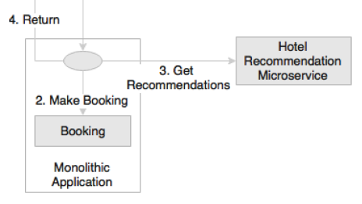
Example
Notes:
In another example of an airline booking website, the airline wants to show personalized hotel recommendations in their booking page. The recommendations must be displayed on the booking confirmation page.
As shown in the preceding diagram, it is convenient to write a microservice that can be plugged into the monolithic applications booking flow rather than incorporating this requirement in the monolithic application itself. The airline may choose to start
with a simple recommendation service and keep replacing it with newer versions till it meets the required accuracy.

Slide 51
3. Elastically and selectively scalable
As microservices are smaller units of work, they enable us to implement selective scalability.
Scale Cube defines primarily three approaches to scaling an application:
Scaling the x axis by horizontally cloning the application
Scaling the y axis by splitting different functionality
Scaling the z axis by partitioning or sharding the data

Slide 52
3. Elastically and selectively scalable (Cont.) Monolithic Applications
A monolithic application, packaged as a single WAR or an EAR, can only be scaled as a whole.
When y axis scaling is applied to monolithic applications, it breaks the monolithic to smaller units aligned with business functions
An I/O-intensive function when streamed with high velocity data could easily bring down the service levels of the entire application.
Notes:
In principle, the resulting units of functions are in line with the microservices characteristics.

Slide 53
3. Elastically and selectively scalable (Cont.) Microservices
In the case of microservices, each service could be independently scaled up or down.
As scalability can be selectively applied at each service, the cost of scaling is comparatively less with the microservices approach.

Slide 54
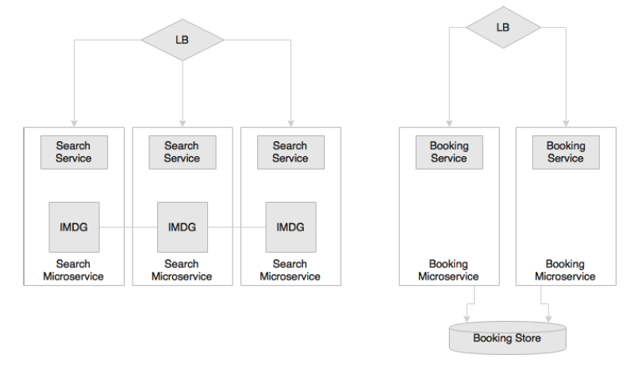
Example
Notes:
Selective Scaling:
For instance, in a typical airline website, statistics indicate that the ratio of flight searching to flight booking could be as high as 500:1. This means one booking transaction for every 500 search transactions. In this scenario, the search needs 500 times more scalability than the booking function. This is an ideal use case for selective scaling.
With a monolithic architecture, this is only possible with z scaling in the scale cube.
However, this approach is expensive because in the z scale, the entire code base is replicated.
In the preceding diagram, Search and Booking are designed as different microservices so that Search can be scaled differently from Booking. In the diagram, Search has
three instances, and Booking has two instances. Selective scalability is not limited to the number of instances, as shown in the diagram, but also in the way in which
the microservices are architected. In the case of Search, an in-memory data grid (IMDG) such as Hazelcast can be used as the data store. This will further increase the
performance and scalability of Search. When a new Search microservice instance is instantiated, an additional IMDG node is added to the IMDG cluster. Booking does
not require the same level of scalability. In the case of Booking, both instances of the Booking microservice are connected to the same instance of the database.

Slide 55
4. Allowing substitution
Microservices are self-contained, independent deployment modules enabling the substitution of one microservice with another similar microservice.
Notes:
Many large enterprises follow buy-versus-build policies to implement software systems.
A common scenario is to build most of the functions in house and buy certain niche capabilities from specialists outside.
* This poses challenges in traditional monolithic applications as these application components are highly cohesive.
* Attempting to plug in third-party solutions to the monolithic applications results in complex integrations.
Architecturally, a microservice can be easily replaced by another microservice developed either in-house or even extended by a microservice from a third party

Slide 56
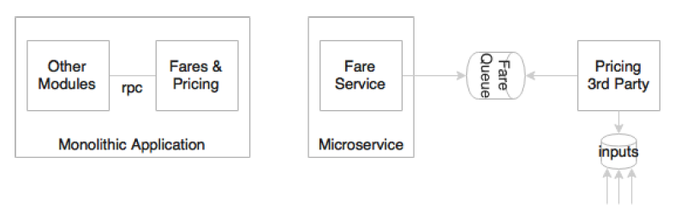
Example
Notes:
A pricing engine in the airline business is complex. Fares for different routes are calculated using complex mathematical formulas known as the pricing logic. Airlines
may choose to buy a pricing engine from the market instead of building the product in house.
In the monolithic architecture, Pricing is a function of Fares and Booking.
In most cases Pricing, Fares, and Booking are hardwired, making it almost impossible to detach.
In a well-designed microservices system, Booking, Fares, and Pricing would be independent microservices. Replacing the Pricing microservice will have only a minimal impact on any other services as they are all loosely coupled and independent. Today, it could be a third-party service; tomorrow, it could be easily substituted by another third-party or home-grown service

Slide 57
5. Enabling to build organic systems
Organic systems are systems that grow laterally over a period of time by adding more and more functions to it.
In practice, an application grows unimaginably large in its lifespan, and in most cases, the manageability of the application reduces dramatically over this same period of time

Slide 58
5. Enabling to build organic systems (Microservices)
Microservices are all about independently manageable services
This enable us to keep adding more and more services as the need arises with minimal impact on the existing services

Slide 59
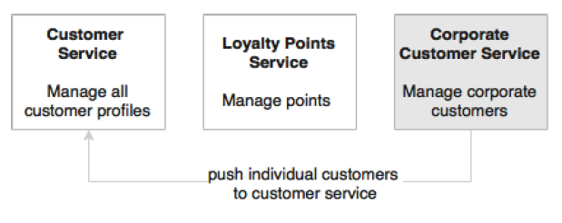
Example
Notes:
In this example, a loyalty system in an airline was built years ago, targeting individual passengers.
Everything was fine until the airline started offering loyalty benefits to their corporate customers.
Corporate customers are individuals grouped under corporations.
As the current systems core data model is flat, targeting individuals, the corporate environment needs a fundamental change in the core data model, and hence huge reworking, to incorporate this requirement.
As shown in the preceding diagram, in a microservices-based architecture, customer information would be managed by the Customer microservice and loyalty by the Loyalty Points microservice.
In this situation, it is easy to add a new Corporate Customer microservice to manage corporate customers.
When a corporation is registered, individual members will be pushed to the Customer microservice to manage them as usual.
The Corporate Customer microservice provides a corporate view by aggregating data from the Customer microservice. It will also provide services to support corporate-specific business rules.
With this approach, adding new services will have only a minimal impact on the existing services.

Slide 60
6. Helping reducing technology debt
As microservices are smaller in size and have minimal dependencies, they allow the migration of services that use end-of-life technologies with minimal cost
In many traditional monolithic applications, due to the fast changes in technologies, today’s next-generation applications could easily become legacy even before their release to production.
With microservices, it is possible to change or upgrade technology for each service individually rather than upgrading an entire application

Slide 61
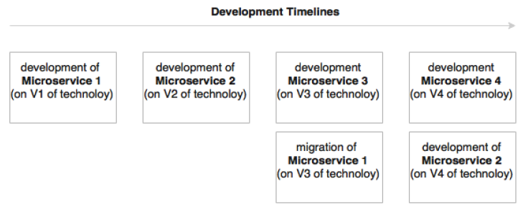
Example
Notes:
Upgrading an application with, for instance, five million lines written on EJB 1.1 and Hibernate to the Spring, JPA, and REST services is almost similar to rewriting the entire application. In the microservices world, this could be done incrementally.
As shown in the preceding diagram, while older versions of the services are running on old versions of technologies, new service developments can leverage the latest technologies. The cost of migrating microservices with end-of-life technologies is considerably less compared to enhancing monolithic applications.

Slide 62
7. Allowing the coexistence of different versions
As microservices package the service runtime environment along with the service itself, this enables having multiple versions of the service to coexist in the same environment.
Care needs to be taken at the database level to ensure the database design is always backward compatible to avoid breaking the changes.
Notes:
There will be situations where we will have to run multiple versions of the same service at the same time. Zero downtime promote, where one has to gracefully switch over from one version to another, is one example of a such a scenario as there will be a time window where both services will have to be up and running simultaneously.
With monolithic applications, this is a complex procedure because upgrading new services in one node of the cluster is cumbersome as, for instance, this could lead to class loading issues. A canary release, where a new version is only released to a few users to validate the new service, is another example where multiple versions of the services have to coexist.
With microservices, both these scenarios are easily manageable. As each microservice uses independent environments, including service listeners such as Tomcat or Jetty
embedded, multiple versions can be released and gracefully transitioned without many issues. When consumers look up services, they look for specific versions of
services. For example, in a canary release, a new user interface is released to user A. When user A sends a request to the microservice, it looks up the canary release
version, whereas all other users will continue to look up the last production version.

Slide 63
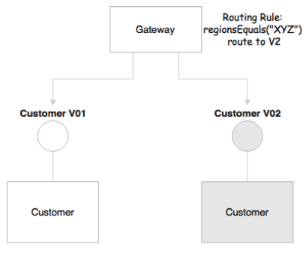
Example
Notes:
As shown in the preceding diagram, version 1 and 2 of the Customer service can coexist as they are not interfering with each other, given their respective deployment environments. Routing rules can be set at the gateway to divert traffic to specific instances, as shown in the diagram. Alternatively, clients can request specific versions as part of the request itself. In the diagram, the gateway selects the version based on the region from which the request is originated.

Slide 64
8. Supporting the building of self-organizing systems
Microservices help us build self-organizing systems. A self-organizing system support will automate deployment, be resilient, and exhibit self-healing and self-learning capabilities.

Slide 65
8. Supporting the building of self-organizing systems (cont.)
In a well-architected microservices system, a service is unaware of other services. It accepts a message from a selected queue and processes it. At the end of the process, it may send out another message, which triggers other services. This allows us to drop any service into the ecosystem without analyzing the impact on the overall system.
Based on the input and output, the service will self-organize into the ecosystem. No additional code changes or service orchestration is required. There is no central brain to control and coordinate the processes

Slide 66
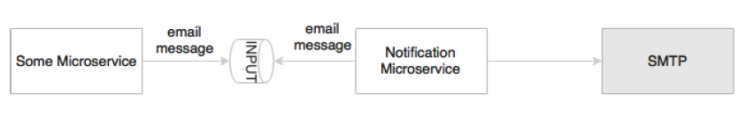
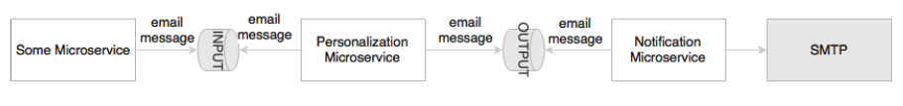
Example
Notes:
Imagine an existing notification service that listens to an INPUT queue and sends notifications to an SMTP server, as shown in the figure on the left.
Let's assume, later, a personalization engine, responsible for changing the language of the message to the customer's native language, needs to be introduced to personalize messages before sending them to the customer, the personalization engine is responsible for changing the language of the message to the customer's
native language.
With microservices, a new personalization microservice will be created to do this job. The input queue will be configured as INPUT in an external configuration server, and the personalization service will pick up the messages from the INPUT queue (earlier, this was used by the notification service) and send the messages to the OUTPUT queue after completing process. The notification services input queue will then send to OUTPUT. From the very next moment onward, the system automatically adopts this new message flow.

Slide 67
9. Supporting event-driven architecture
Microservices enable us to develop transparent software systems.
Traditional systems communicate with each other through native protocols and hence behave like a black box application
Business events and system events, unless published explicitly, are hard to understand and analyze.
Modern applications require data for business analysis, to understand dynamic system behaviors, and analyze market trends, and they also need to respond to real-time events
Events are useful mechanisms for data extraction.
Notes:
A well-architected microservice always works with events for both input and output. These events can be tapped by any service. Once extracted, events can be used for
a variety of use cases

Slide 68
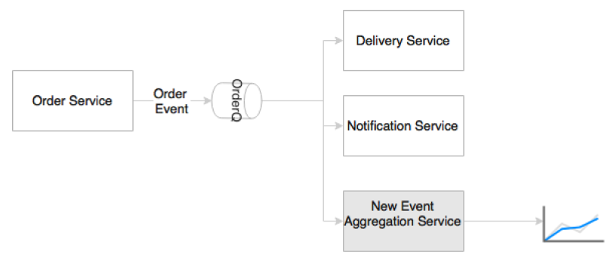
Example
Notes:
For example, the business wants to see the velocity of orders categorized by product type in real time.
In a monolithic system, we need to think about how to extract these events. This may impose changes in the system.
In the microservices world, Order Event is already published whenever an order is created. This means that it is just a matter of adding a new service to subscribe to the
same topic, extract the event, perform the requested aggregations, and push another event for the dashboard to consume.

Slide 69
10. Enabling DevOps
Microservices are one of the key enablers of DevOps
DevOps is widely adopted as a practice in many enterprises, primarily to increase the speed of delivery and agility.
A successful adoption of DevOps requires cultural changes, process changes, as well as architectural changes
DevOps advocates to have agile development, high-velocity release cycles, automatic testing, automatic infrastructure provisioning, and automated deployment.

Slide 70
10. Enabling DevOps (Cont.)
Automating all these processes is extremely hard to achieve with traditional monolithic applications.
Microservices are not the ultimate answer, but microservices are at the center stage in many DevOps implementations. Many DevOps tools and techniques are also evolving around the use of microservices.

Slide 71
10. Enabling DevOps (Cont.) Monolithic example
Consider a monolithic application that takes hours to complete a full build and 20 to 30 minutes to start the application; one can see that this kind of application is not ideal for DevOps automation.
It is hard to automate continuous integration on every commit.
As large, monolithic applications are not automation friendly, continuous testing and deployments are also hard to achieve.

Slide 72
10. Enabling DevOps (Cont.) Microservice Example
On the other hand, small footprint microservices are more automation-friendly and therefore can more easily support these requirements.
Microservices also enable smaller, focused agile teams for development. Teams will be organized based on the boundaries of microservices.

Slide 73
Relationship with other architecture styles
Relations with SOA
Relations with Twelve-Factor apps

Slide 74
SOA
"Service-Oriented Architecture (SOA) is an architectural style that supports service orientation. Service orientation is a way of thinking in terms of services and service-based development and the outcomes of services.
A service:
* Is a logical representation of a repeatable business activity that has a specified outcome (e.g., check customer credit, provide weather data, consolidate drilling reports)
* It is self-contained.
* It may be composed of other services.
* It is a "black box" to consumers of the service."

Slide 75
SOA vs Microservices
in what way are microservices different?
The answer is: it depends.
SOA is a broader term, and different organizations approached SOA differently to solve different organizational problems. The difference between microservices and SOA is in a way based on how an organization approaches SO

Slide 76
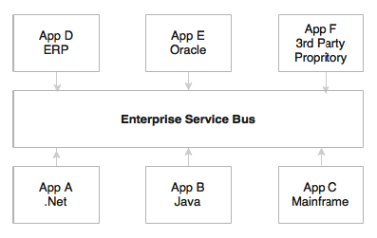
Service-oriented integration
Notes:
Service-oriented integration refers to a service-based integration approach used by many organizations.
Generally, this is termed as Service-Oriented Integration (SOI): Many organizations would have used SOA primarily to solve their integration complexities, also known as integration spaghetti
Applications communicate with each other through a common integration layer using standard protocols and message formats such as SOAP/XML-based web services over HTTP or JMS. These types of organizations focus on Enterprise Integration Patterns (EIP) to model their integration requirements.
This approach strongly relies on heavyweight ESB such as TIBCO Business Works, WebSphere ESB, Oracle ESB, and the likes.
They either write heavy orchestration logic in the ESB layer or the business logic itself in the service bus. In both cases, all enterprise services are deployed and accessed via ESB
These services are managed through an enterprise governance model. For such organizations, microservices are altogether different from SOA.

Slide 77
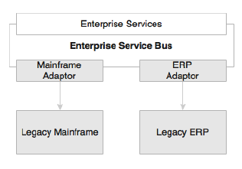
Legacy Modernization
Notes:
SOA is also used to build service layers on top of legacy applications.
Another category of organizations would use SOA in transformation projects or legacy modernization projects.
In such cases, the services are built and deployed in the ESB layer connecting to backend systems using ESB adapters. For these organizations, microservices are different from SOA.

Slide 78
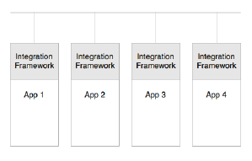
Service-oriented application
Notes:
In this approach, lightweight integration frameworks, such as Apache Camel or Spring Integration, are embedded within applications to handle service-related cross-cutting capabilities such as protocol mediation, parallel execution, orchestration, and service integration.
As some of the lightweight integration frameworks have native Java object support, such applications would even use native Plain Old Java Objects (POJO) services for integration and data exchange between services. As a result, all services have to be packaged as one monolithic web archive. Such organizations could see microservices as the next logical step of their SOA.

Slide 79
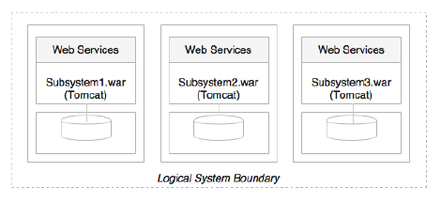
Monolithic migration using SOA
Notes:
The last possibility is transforming a monolithic application into smaller units after hitting the breaking point with the monolithic system.
They would break the application into smaller, physically deployable subsystems, similar to the y axis scaling approach explained earlier, and deploy them as web archives on web servers or as JARs deployed on some home-grown containers
These subsystems as service would use web services or other lightweight protocols to exchange data between services. They would also use SOA and service design principles to achieve this. For such organizations, they may tend to think that microservices are the same old wine in a new bottle.

Slide 80
Relations with Twelve-Factor apps
Cloud computing is one of the rapidly evolving technologies. Cloud computing promises many benefits, such as cost advantage, speed, agility, flexibility, and elasticity
Different cloud providers such as AWS, Microsoft, Rackspace, IBM, Google, and so on use different tools, technologies, and services.
On the other hand, enterprises are aware of this evolving battlefield and, therefore, they are looking for options for de-risking from lockdown to a single vendor.

Slide 81
Relations with Twelve-Factor apps (Cont.)
Many organizations do lift and shift their applications to the cloud. In such cases, the applications may not realize all the benefits promised by cloud platforms.
Some applications need to undergo overhaul, whereas some may need minor tweaking before moving to cloud.
This by and large depends upon how the application is architected and developed.

Slide 82
What is Cloud Native?
Cloud native is a term used for developing applications that can work efficiently in a cloud environment, understanding and utilizing cloud behaviors such as elasticity, utilization based charging, fail aware, and so on.

Slide 83
For example, if the application has its production database server URLs hardcoded as part of the applications WAR, it needs to be modified before moving the application to cloud.
In the cloud, the infrastructure is transparent to the application, and especially, the physical IP addresses cannot be assumed.
How do we ensure that an application, or even microservices, can run seamlessly across multiple cloud providers and take advantages of cloud services such as elasticity?
It is important to follow certain principles while developing cloud native applications.

Slide 84
Relations with Twelve-Factor apps (Cont.)
Twelve-Factor App, forwarded by Heroku, is a methodology describing the characteristics expected from modern cloud-ready applications.
Twelve-Factor App is equally applicable for microservices as well. Hence, it is important to understand Twelve-Factor App.

Slide 85
Twelve-Factor apps Characteristics
A single code base
Bundling dependencies
Externalizing configurations
Backing services are addressable
Isolation between build, release, and run
Stateless, shared nothing processes
Exposing services through port bindings
Concurrency to scale out
Disposability with minimal overhead
Development and production parity
Externalizing logs
Package admin processes

Slide 86
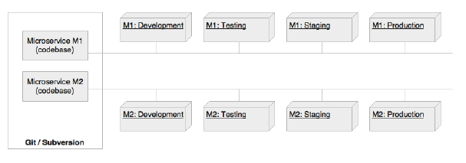
A single code base

Slide 87
A single code base
The code base principle advises that each application has a single code base. There can be multiple instances of deployment of the same code base, such as development, testing, and production.
Code is typically managed in a source control system such as Git, Subversion, and so on
Extending the same philosophy for microservices, each microservice should have its own code base, and this code base is not shared with any other microservice. It also means that one microservice has exactly one code base.

Slide 88
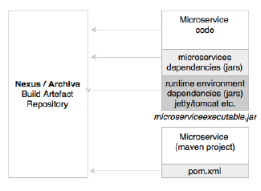
Bundling dependencies

Slide 89
Bundling dependencies
As per this principle, all applications should bundle their dependencies along with the application bundle.
With build tools such as Maven and Gradle, we explicitly manage dependencies in a pom.xml or the .gradle file and link them using a central build artifact repository such as Nexus or Archiva.
This ensures that the versions are managed correctly.
The final executables will be packaged as a WAR file or an executable JAR file, embedding all the dependencies.

Slide 90
Bundling dependencies (Cont.)
In the context of microservices, this is one of the fundamental principles to be followed.
Each microservice should bundle all the required dependencies and execution libraries such as the HTTP listener and so on in the final executable bundle.

Slide 91
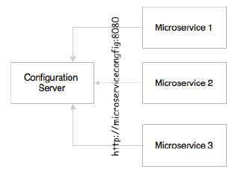
Externalizing configurations

Slide 92
Externalizing configurations
This principle advises the externalization of all configuration parameters from the code.
An application's configuration parameters vary between environments, such as support to the e-mail IDs or URL of an external system, username, passwords, queue name, and so on.
These will be different for development, testing, and production.
All service configurations should be externalized.

Slide 93
Externalizing configurations (Cont.)
The same principle is obvious for microservices as well.
The microservices configuration parameters should be loaded from an external source.
This will also help to automate the release and deployment process as the only difference between these environments is the configuration parameters

Slide 94
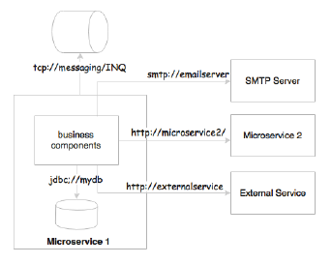
Backing services are addressable

Slide 95
Backing services are addressable
All backing services should be accessible through an addressable URL.
All services need to talk to some external resources during the life cycle of their execution.
For example, they could be listening or sending messages to a messaging system, sending an e-mail, persisting data to database, and so on.
All these services should be reachable through a URL without complex communication requirements

Slide 96
Backing services are addressable (Cont.)
In the microservices world, microservices either talk to a messaging system to send or receive messages, or they could accept or send messages to other service APIs.
In a regular case, these are either HTTP endpoints using REST and JSON or TCP- or HTTP-based messaging endpoints.

Slide 97
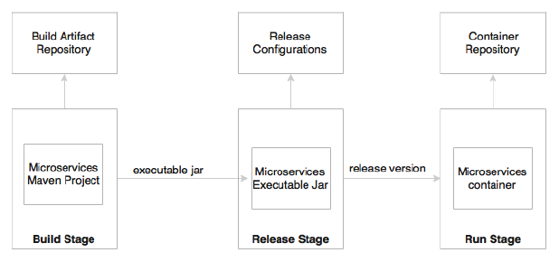
Isolation between build, release, and run

Slide 98
Isolation between build, release, and run
This principle advocates a strong isolation between the build, release, and run stages.

Slide 99
Isolation between build, release, and run
The build stage refers to compiling and producing binaries by including all the assets required.
The release stage refers to combining binaries with environment specific configuration parameters
The run stage refers to running application on a specific execution environment.
The pipeline is unidirectional, so it is not possible to propagate changes from the run stages back to the build stage. Essentially, it also means that it is not recommended to do specific builds for production; rather, it has to go through the pipeline.

Slide 100
Isolation between build, release, and run
In microservices, the build will create executable JAR files, including the service runtime such as an HTTP listener.
During the release phase, these executables will be combined with release configurations such as production URLs and so on and create a release version, most probably as a container similar to Docker.
In the run stage, these containers will be deployed on production via a container scheduler.

Slide 101
Stateless, shared nothing processes
This principle suggests that processes should be stateless and share nothing.
If the application is stateless, then it is fault tolerant and can be scaled out easily.
All microservices should be designed as stateless functions.
If there is any requirement to store a state, it should be done with a backing database or in an in-memory cache.

Slide 102
Exposing services through port bindings
A Twelve-Factor application is expected to be self-contained.
Traditionally, applications are deployed to a server: a web server or an application server such as Apache Tomcat or JBoss.
A Twelve-Factor application does not rely on an external web server. HTTP listeners such as Tomcat or Jetty have to be embedded in the service itself.
Port binding is one of the fundamental requirements for microservices to be autonomous and self-contained.
Microservices embed service listeners as a part of the service itself.

Slide 103
Concurrency to scale out
This principle states that processes should be designed to scale out by replicating the processes. This is in addition to the use of threads within the process.
In the microservices world, services are designed to scale out rather than scale up.
The x axis scaling technique is primarily used for a scaling service by spinning up another identical service instance. The services can be elastically scaled or shrunk based on the traffic flow.
Further to this, microservices may make use of parallel processing and concurrency frameworks to further speed up or scale up the transaction processing.

Slide 104
Disposability with minimal overhead
This principle advocates building applications with minimal startup and shutdown times with graceful shutdown support.
In an automated deployment environment, we should be able bring up or bring down instances as quick as possible. If the application's startup or shutdown takes considerable time, it will have an adverse effect on automation.
The startup time is proportionally related to the size of the application.
In a cloud environment targeting auto-scaling, we should be able to spin up new instance quickly. This is also applicable when promoting new versions of services.

Slide 105
Disposability with minimal overhead
In the microservices context, in order to achieve full automation, it is extremely important to keep the size of the application as thin as possible, with minimal startup and shutdown time.
Microservices also should consider a lazy loading of objects and data.

Slide 106
Development and production parity
This principle states the importance of keeping development and production environments as identical as possible.
For example, let's consider an application with multiple services or processes, such as a job scheduler service, cache services, and one or more application services. In a development environment, we tend to run all of them on a single machine, whereas in production, we will facilitate independent machines to run each of these processes.
This is primarily to manage the cost of infrastructure.
The downside is that if production fails, there is no identical environment to re-produce and fix the issues.
Not only is this principle valid for microservices, but it is also applicable to any application development.

Slide 107
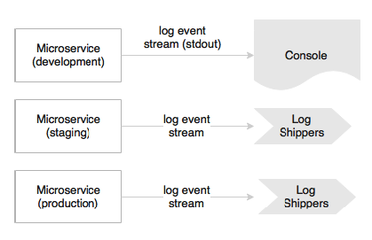
Externalizing logs

Slide 108
Externalizing logs
A Twelve-Factor application never attempts to store or ship log files.
In a cloud, it is better to avoid local I/Os. If the I/Os are not fast enough in a given infrastructure, it could create a bottleneck.
The solution to this is to use a centralized logging framework.
Splunk, Greylog, Logstash, Logplex, and Loggly are some examples of log shipping and analysis tools.
The recommended approach is to ship logs to a central repository by tapping the logback appenders and write to one of the shippers' endpoints.

Slide 109
Externalizing logs
In a microservices ecosystem, this is very important as we are breaking a system into a number of smaller services, which could result in decentralized logging.
If they store logs in a local storage, it would be extremely difficult to correlate logs between services.
In development, the microservice may direct the log stream to stdout, whereas in production, these streams will be captured by the log shippers and sent to a central log service for storage and analysis.

Slide 110
Package admin processes
Apart from application services, most applications provide admin tasks as well.
This principle advises to use the same release bundle as well as an identical environment for both application services and admin tasks.
Admin code should also be packaged along with the application code.
Not only is this principle valid for microservices, but also it is applicable to any application development.

Slide 111
Microservice use cases
A microservice will not solve all the architectural challenges of today's world. There is no hard-and-fast rule or rigid guideline on when to use microservices
Microservices may not fit in each and every use case.
The success of microservices largely depends on the selection of use cases
The first and the foremost activity is to do a test of the use case against the microservices' benefits in a way that covers all the microservices' benefits we discussed earlier.
For a given use case, if there are no quantifiable benefits or the cost outweighs the benefits, then the use case may not be the right choice for microservices.

Slide 112
Valid Use case Scenarios
Migrating a monolithic application due to improvements required in scalability, manageability, agility, or speed of delivery.
Rewriting an end-of-life heavily used legacy application.
Integrating an optimization service, forecasting service, price calculation service, prediction service, offer service, recommendation service, and so on are good candidates for microservices.
Independent technical services such as the communication service, the encryption service, authentication services, and so on are also good candidates for microservices
Notes:
1 ,2 : In both first and second cases, microservices present an opportunity. Using a microservices architecture, it is possible to re-platform a legacy application by slowly transforming functions to microservices.
There are benefits in this approach. There is no huge upfront investment required, no major disruption to business, and no severe business risks. As the service dependencies are known, the microservices dependencies can be well managed.
3 , 4 : These are independent stateless computing units that accept certain data, apply algorithms, and return the results.

Slide 113
Valid Use case Scenarios (Cont.)
In many cases, we can build headless business applications or services that are autonomous in nature—for instance, the payment service, login service, flight search service, customer profile service, notification service, and so on.
These are normally reused across multiple channels and, hence, are good candidates for building them as microservices.
There could be micro or macro applications that serve a single purpose and performing a single responsibility.
Backend services of a well-architected, responsive client-side MVC web application (the Backend as a Service (BaaS) scenario) load data on demand in response to the user navigation.
Notes:
3: A simple time tracking application is an example of this category. All it does is capture the time, duration, and task performed. Common-use enterprise applications are also candidates for microservices.
4: In most of these scenarios, data could be coming from multiple logically different data sources as described in the Fly By Points example mentioned earlier.

Slide 114
Valid Use case Scenarios (Cont.)
Highly agile applications, applications demanding speed of delivery or time to market, innovation pilots, applications selected for DevOps, applications of the System of Innovation type, and so on could also be considered as potential candidates for the microservices architecture
Applications that we could anticipate getting benefits from microservices such as polyglot requirements, applications that require Command Query Responsibility segregations (CQRS), and so on are also potential candidates of the microservices architecture.
For more examples on CQRS, please check http://microservices.io/patterns/data/cqrs.html
Notes:
Command Query Responsibility segregations (CQRS):
This answers the question: How to implement queries in a microservice architecture?
Solution:
Split the application into two parts: the command-side and the query-side. The command-side handles create, update, and delete requests and emits events when data changes. The query-side handles queries by executing them against one or more materialized views that are kept up to date by subscribing to the stream of events emitted when data changes.
For more info. , check http://microservices.io/patterns/data/cqrs.html

Slide 115
When To Avoid Microservices?
If the organization's policies are forced to use centrally managed heavyweight components such as ESB to host a business logic or if the organization has any other policies that hinder the fundamental principles of microservices, then microservices are not the right solution unless the organizational process is relaxed.
If the organization's culture, processes, and so on are based on the traditional waterfall delivery model, lengthy release cycles, matrix teams, manual deployments and cumbersome release processes, no infrastructure provisioning, and so on, then microservices may not be the right fit.
Notes:
2: This is underpinned by Conway's Law. This states that there is a strong link between the organizational structure and software it creates.

Slide 116
Microservices early adopters
Netflix (www.netflix.com)
Uber (www.uber.com)
Airbnb (www.airbnb.com)
Orbitz (www.orbitz.com)
eBay (www.ebay.com)
Amazon (www.amazon.com)
Gilt (www.gilt.com)
Twitter (www.twitter.com):
Nike (www.nike.com)
Notes:
Netflix (www.netflix.com): Netflix, an international on-demand media streaming company, is a pioneer in the microservices space.
Netflix transformed their large pool of developers developing traditional monolithic code to smaller development teams producing microservices. These microservices work together to stream digital media to millions of Netflix customers.
At Netflix, engineers started with monolithic, went through the pain, and then broke the application into smaller units that are loosely coupled and aligned to the business capability.
• Uber (www.uber.com): Uber, an international transportation network company, began in 2008 with a monolithic architecture with a single code base. All services were embedded into the monolithic application. When Uber expanded their business from one city to multiple cities, the challenges started.
Uber then moved to SOA-based architecture by breaking the system into smaller independent units. Each module was given to different teams and empowered them to choose their language, framework, and database.
Uber has many microservices deployed in their ecosystem using RPC and REST.
• Airbnb (www.airbnb.com): Airbnb, a world leader providing a trusted marketplace for accommodation, started with a monolithic application that performed all the required functions of the business.
Airbnb faced scalability issues with increased traffic. A single code base became too complicated to manage, resulted in a poor separation of concerns, and ran into performance issues.
Airbnb broke their monolithic application into smaller pieces with separate code bases running on separate machines with separate deployment cycles.
Airbnb developed their own microservices or SOA ecosystem around these services.
• Orbitz (www.orbitz.com): Orbitz, an online travel portal, started with a monolithic architecture in the 2000s with a web layer, a business layer, and a database layer. As Orbitz expanded their business, they faced manageability and scalability issues with monolithic-tiered architecture. Orbitz then went through continuous architecture changes.
Later, Orbitz broke down their monolithic to many smaller applications.
• eBay (www.ebay.com): eBay, one of the largest online retailers, started in the late 1990s with a monolithic Perl application and FreeBSD as the database.
eBay went through scaling issues as the business grew. It was consistently investing in improving its architecture. In the mid 2000s, eBay moved to smaller decomposed systems based on Java and web services. They employed database partitions and functional segregation to meet the required scalability.
• Amazon (www.amazon.com): Amazon, one of the largest online retailer websites, was run on a big monolithic application written on C++ in 2001. The well-architected monolithic application was based on a tiered architecture with many modular components. However, all these components were tightly coupled. As a result, Amazon was not able to speed up their development cycle by splitting teams into smaller groups. Amazon then separated out the code as independent functional services, wrapped
with web services, and eventually advanced to microservices.
• Gilt (www.gilt.com): Gilt, an online shopping website, began in 2007 with a tiered monolithic Rails application and a Postgres database at the back. Similarly to many other applications, as traffic volumes increased, the web application was not able to provide the required resiliency.
Gilt went through an architecture overhaul by introducing Java and polyglot persistence. Later, Gilt moved to many smaller applications using the microservices concept.
• Twitter (www.twitter.com): Twitter, one of the largest social websites, began with a three-tiered monolithic rails application in the mid 2000s. Later, when Twitter experienced growth in its user base, they went through an architecture-refactoring cycle. With this refactoring, Twitter moved away from a typical web application to an API-based even driven core.
Twitter uses Scala and Java to develop microservices with polyglot persistence.
• Nike (www.nike.com): Nike, the world leader in apparel and footwear, transformed their monolithic applications to microservices. Similarly to many other organizations, Nike too was run with age-old legacy applications that were hardly stable. In their journey, Nike moved to heavyweight commercial products with an objective to stabilize legacy applications but ended up in monolithic applications that were expensive to scale, had long release cycles, and needed too much manual work to deploy and manage applications.
Later, Nike moved to a microservices-based architecture that brought down the development cycle considerably.

Slide 117
The common theme is monolithic migrations
All these enterprises started with monolithic applications and transitioned to a microservices architecture by applying learning and pain points from their previous editions
Many start-ups begin with monolith as it is easy to start, conceptualize, and then slowly move to microservices when the demand arises.
Monolithic to microservices migration scenarios have an added advantage: they have all the information upfront, readily available for refactoring.
The catalysts are different for different organizations. Some of the common motivations are a lack of scalability, long development cycles, process automation, manageability, and changes in the business models.

Slide 118
The common theme is monolithic migrations (Cont.)
On the other hand, there are opportunities to build microservices from the ground up
Look for opportunities to build smaller services that are quick wins for business
For example, adding a trucking service to an airline's end-to-end cargo management system or adding a customer scoring service to a retailer's loyalty system. These could be implemented as independent microservices exchanging messages with their respective monolithic applications.
Also, many organizations use microservices only for their business-critical customer engagement applications, leaving the rest of the legacy monolithic applications to take their own trajectory.
Notes:
Another important observation is that most of the organizations examined previously are at different levels of maturity in their microservices journey.
When eBay transitioned from a monolithic application in the early 2000s, they functionally split the application into smaller, independent, and deployable units. These logically divided units are wrapped with web services. While single responsibility and autonomy are their underpinning principles, the architectures are limited to the
technologies and tools available at that point in time.
Organizations such as Netflix and Airbnb built capabilities of their own to solve the specific challenges they faced.
To summarize, all of these are not truly microservices, but are small, business-aligned services following the same characteristics.

Slide 119
The common theme is monolithic migrations (Cont.)
There is no state called "definite or ultimate microservices".
It is a journey and is evolving and maturing day by day.
The mantra for architects and developers is the replaceability principle; build an architecture that maximizes the ability to replace its parts and minimizes the cost of replacing its parts.
The bottom line is that enterprises shouldn't attempt to develop microservices by just following the hype.

Slide 120
Summary
you learned about the fundamentals of microservices with the help of a few examples.
We explored the evolution of microservices from traditional monolithic applications.
We examined some of the principles and the mind shift required for modern application architectures.
We also took a look at the characteristics and benefits of microservices and use cases.
We established the microservices’ relationship with service-oriented architecture and Twelve-Factor Apps.
Lastly, we analyzed examples of a few enterprises from different industries.

